Slide 1
The Wild Toboggan Ride

Slide 2
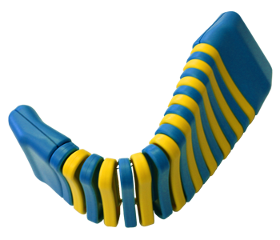
Toboggan

Slide 3
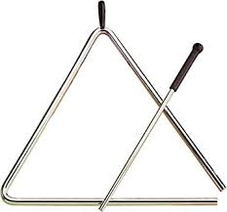
Scarf

Slide 4
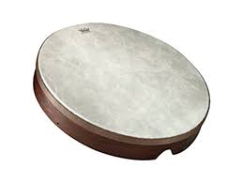
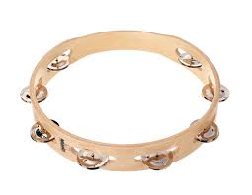
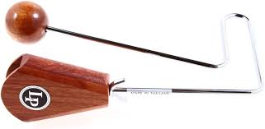
Bump Oomph Crash

Slide 5
Characters:
Grandpa Dan- Bass xylophone
Nicki- glockenspiel
Baker-guiro
Barber-finger cymbals
Police Chief-whistle
Mail Carrier- crinkle paper
Hockey Player-rhythm sticks

Slide 6
Boot

Slide 7
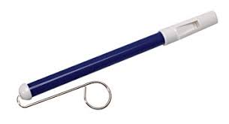
Slipped

Slide 8
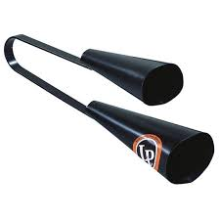
Garbage Can

Slide 9
Running
ALL INSTRUMENTS PLAY

